Slide 1







Analysis of Main Transportation Modes Based on Toyosu PP
14_Saitama Univ.
Takanori Nakano,Osuke Kobayashi
Haruto Suzuki, Hinata Otomo

Slide 2
Contents
01
Background and Objectives
02
Data and Methods
03
Basic Analysis
04
Model-Based Analysis
Table of
Contents
05
Discussion and Policy evaluation

Slide 3
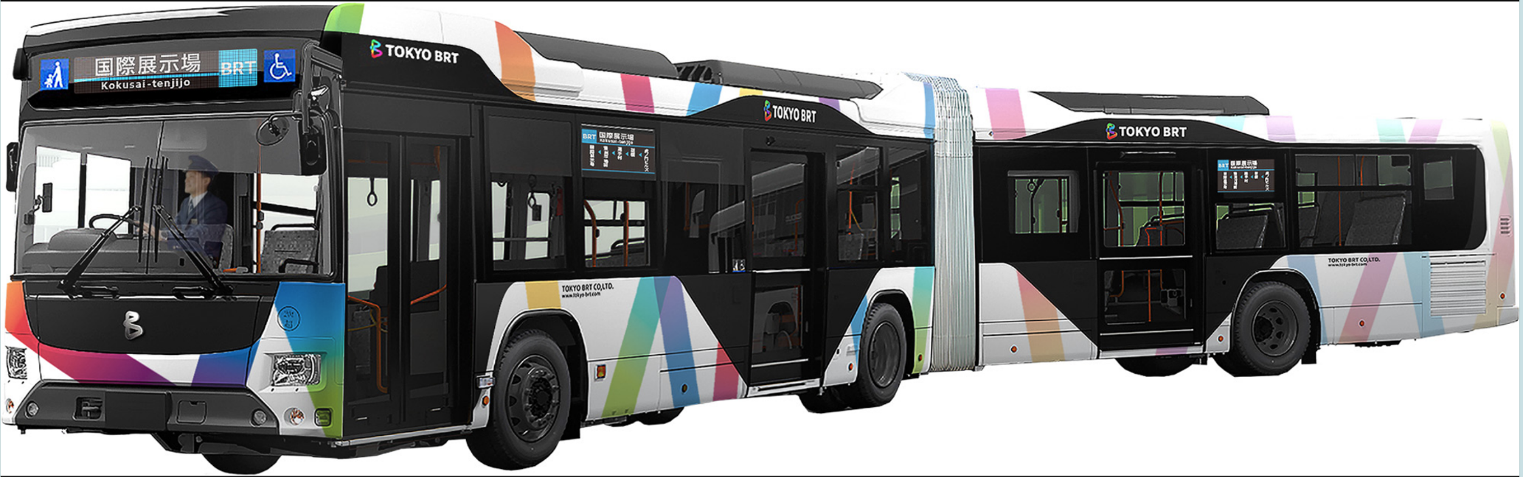
01
Background
◎Toyosu, Tokyo
"Ranked 5th in Tokyo Metro Ridership（2024年度 参考：各駅の乗降人員ランキング｜東京メトロ）
Congestion in Public Transportation Caused by Commuters and Students
The Emergence of BRT as a New Form of Public Transportation
◎Problems
Train→Shift from Railways to Other Public
参考：【市場外】東京BRTが運行開始 新橋ー豊洲市場など | ザ・豊洲市場【公式】
Notes:
東京都 豊洲
東京メトロの乗降者数第５位
通勤・通学者による公共交通の混雑
BRTという新たな公共交通の存在
課題
鉄道→その他公共交通への分散

Slide 4
01
Objectives
Understanding the Current Use of Public Transportation through Basic and Model Analyses
◎For the redistribution from railways to other public transportation, we propose effective time periods for using alternative modes of suggest measures to regulate behaviors that contribute to congestion
Notes:
基礎分析とモデル分析により、現状の公共交通利用状況を把握
鉄道→その他公共交通への分散のため… 鉄道に代わる交通手段利用の効果的な時間帯を提案 混雑に影響を及ぼす行動に制御を掛ける

Slide 5
02
Data and Methods
2021.7.8～8.16，11.1～11.30
Using trip data from 331 individuals
Basic Analysis
linking factors likely to influence changes in transportation mode
examine those factors
Example)
Purpose of travel - Changes in transportation mode
Time of travel - Transportation mode
Length of travel - Transportation mode etc.

Slide 6
02
About the Model
Utilizing the Multiple Nominal Logit Model (MNL)
Dependent variable:
Choice of primary transportation mode
Explanatory variables:
Trip time period (monthly, time-of-day)
Trip purpose
Trip time
OD Direct Distance

Slide 7
03
基礎分析
SeasonーMeans of transportation
No significant changes observed
Summer passenger traffic has surpassed rail and subway ridership

Slide 8
03
基礎分析
Time SlotーMeans of transportation
evening (commuting hours)
→Ratio of people walking or cycling increases.

Slide 9
03
Basic Analysis

Slide 10
03
Basic Analysis
OD Direct DistanceーMeans of transportation
Short distances：
→walking and privately owned bicycles dominate
As distances gradually increase：
→passenger cars, railways, and subways grows
long distances：
railways and subways dominate

Slide 11
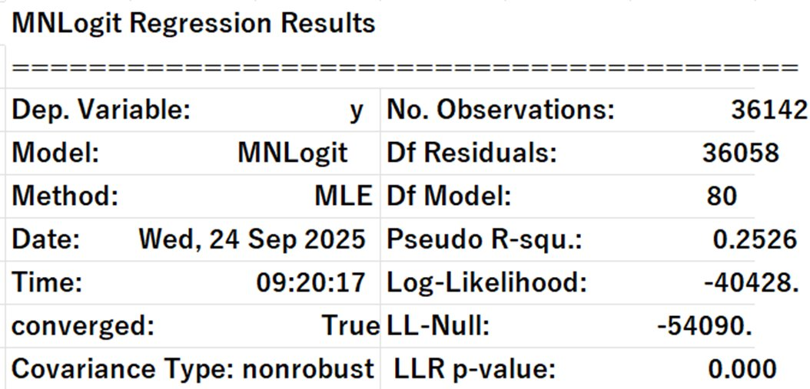
04
Model-based Analysis
Result

Slide 12
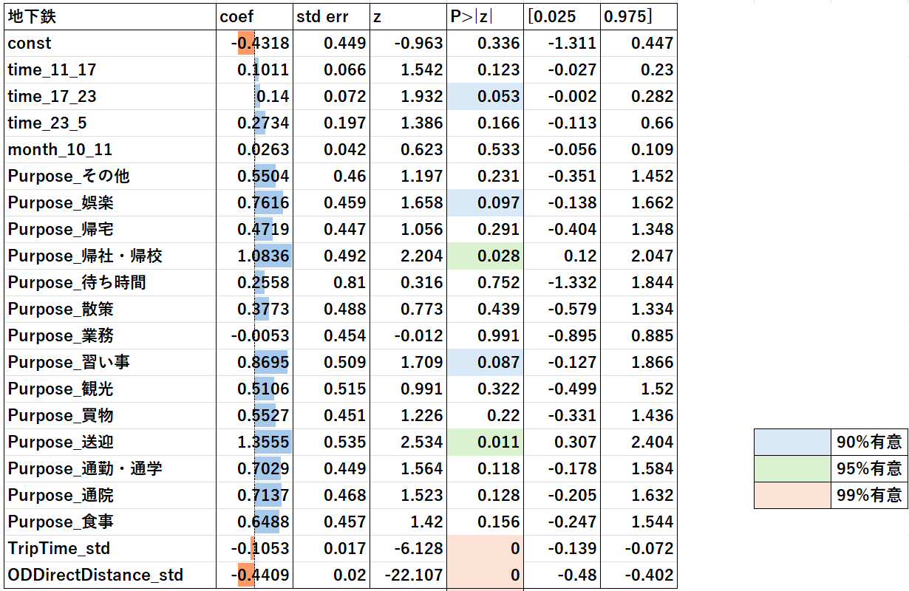
04
Model-based Analysis
SUBWAY

Slide 13
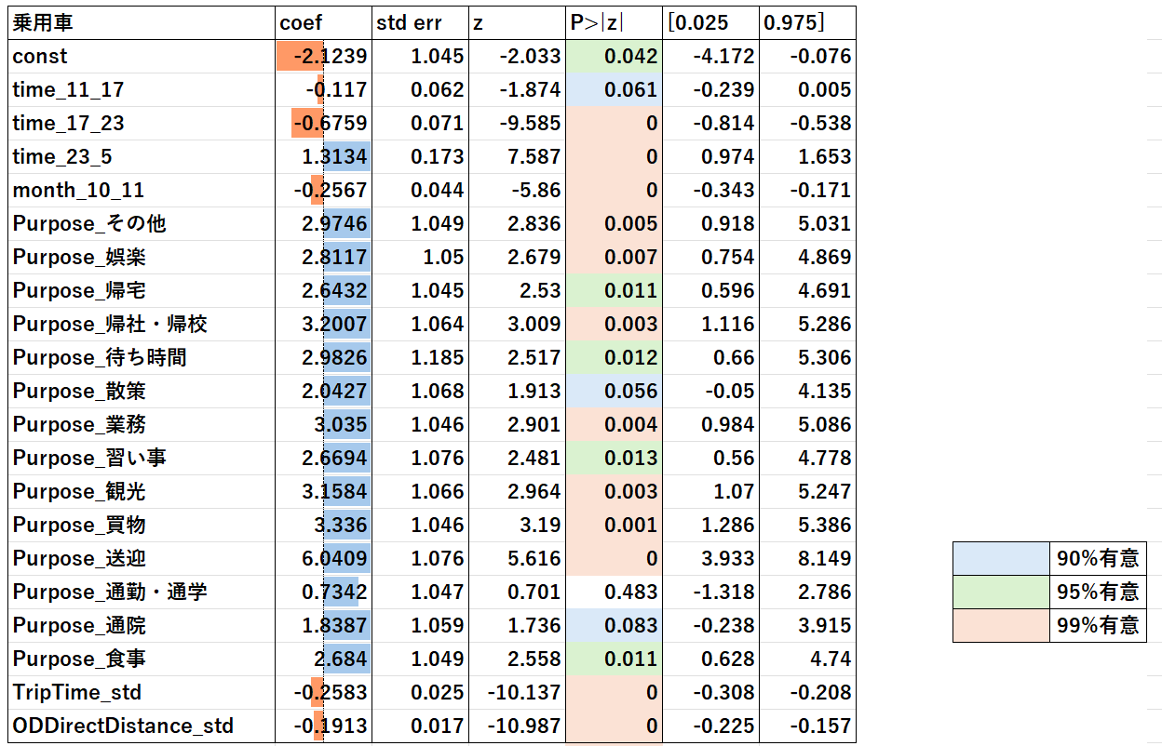
04
Model-based Analysis
Car

Slide 14
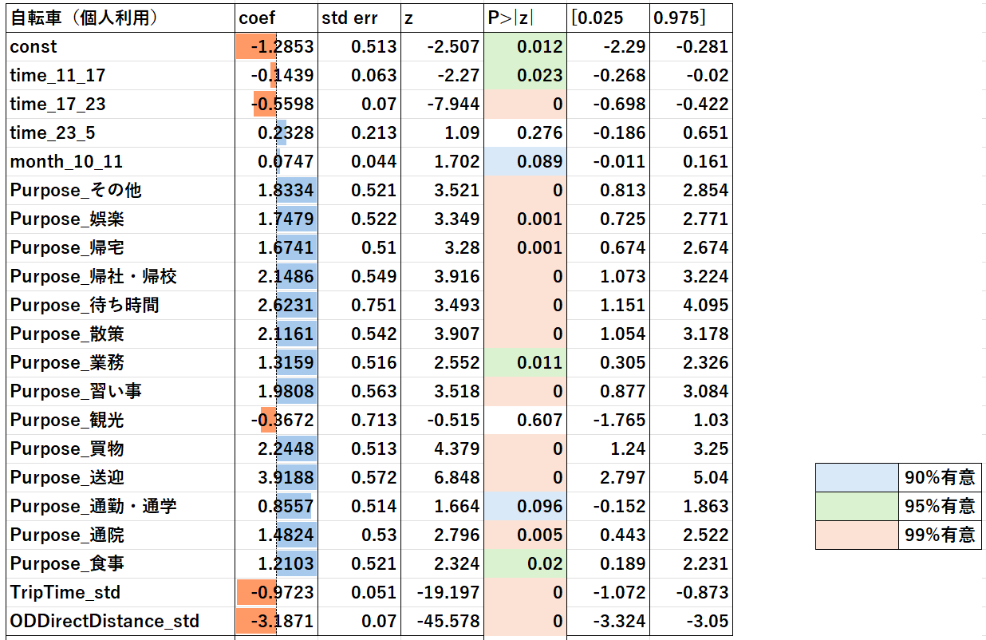
04
Model-based Analysis
Bicycle (Private)

Slide 15
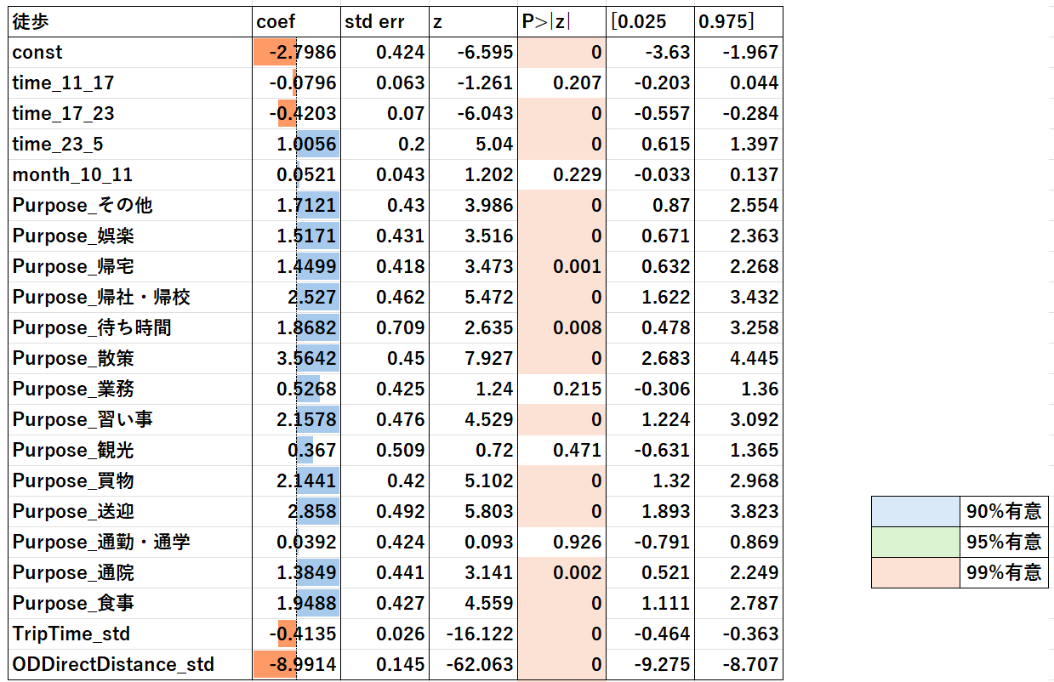
04
Model-based Analysis
Walk

Slide 16
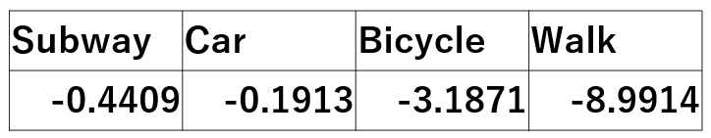
05
Discussion
OD distance and travel time
significant for all dependent variables.
→ Shorter travel time increases the probability of choosing that mode.
Coefficient comparison
→ Walking is strongly affected by distance.
→ Car use is less sensitive to distance compared to other modes.

Slide 17
05
Discussion
Pick and drop off
Highest coefficient for private cars.
Children are most often picked up/dropped off by car.
This behavior may contribute to congestion and increased car traffic in Toyosu.

Slide 18
05
Policy evaluation
Implication
→ This increases congestion and car traffic in the Toyosu area.
Future possibility
→ Reducing car traffic could support the feasibility of introducing BRT in Toyosu.
Key requirement
→ Both car traffic reduction and improved BRT convenience must be pursued simultaneously.

Slide 19
THANK YOU!

Slide 20
付録
基礎分析データ集

