Slide 1

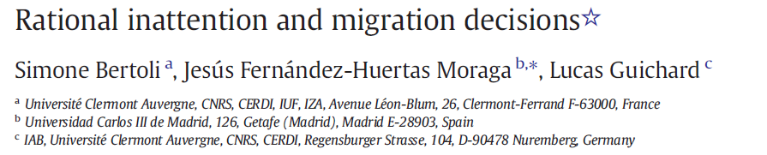
May 16th, 2024
Presenter : Niloofar Yavari
Second year PhD student

Slide 2

Overview of Paper
Traditional Assumption >>> migrants have all necessary information, but uncertainty may persist when choosing a destination.
strategic decisions
To cope with uncertainty >>> Estimating Gravity Model derived from a location-decision problem
Benefits in
destinations
This estimation of gravity model>>> reflecting migrants' incentives to gather information before moving.
face uncertainty
Inaccurate
expectations
Human Migration
Using data on bilateral migration flows
Findings
face uncertainty
inaccurate expectations
migrants invest more in information acquisition when economic conditions change in potential destinations, leading to increased migration flows.

Slide 3
What the paper is going to say?
significant contributions to understanding migration decisions by addressing rational inattention
when utility follows a specific distribution, all destination options are chosen with positive probability
allows us to uncover systematic differences across origins in how migration flows respond to economic conditions in destination countries
complex dynamics of migration decision-making and provides insights into how information frictions shape migration patterns

Slide 4





Theory Implementation
Choice 4
Choice 2
These options are collectively referred to as the choice set.
Each destination offers a certain level of utility >>>
determined by factors like job opportunities and living costs
Choice 3
Choice 1
Costly Process to obtain accurate information
Gathering Information
They aim to maximize their expected utility by selecting the destination with the highest expected payoff based on the information they have.
The probability of choosing a specific destination >>> depends on both the person's belief about the utilities and the information they acquire.
The model streamlines decision-making by linking acquired information directly to destination choices, simplifying the process to assess the likelihood of selecting each destination.

Slide 5
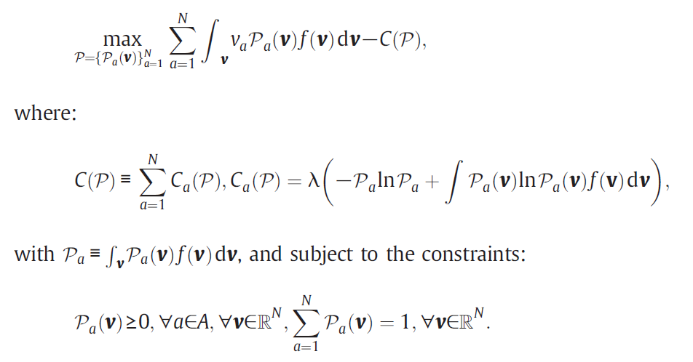

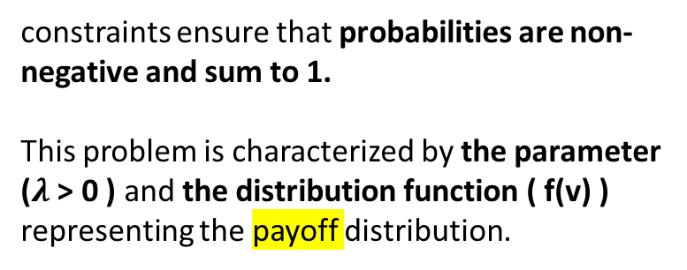
The migrant's decision problem is then expressed as maximizing the expected payoff minus the cost of information acquisition, subject to constraints.
Cost function
cost of acquiring information
constraints ensure that probabilities are non-negative and sum to 1.
This problem is characterized by the parameter ($λ$ > 0 ) and the distribution function ( f(v) ) representing the payoff distribution.

Slide 6



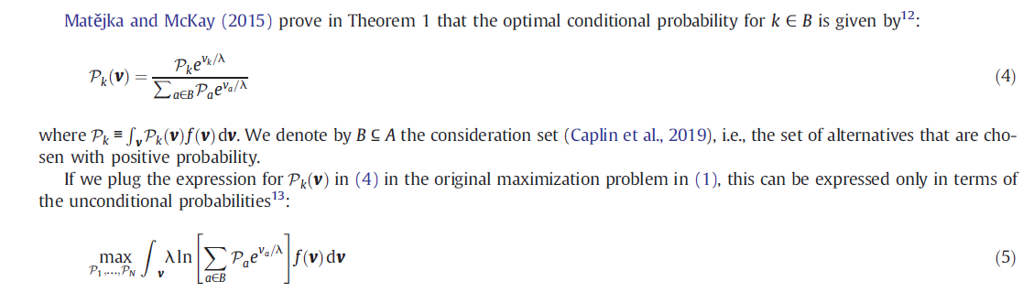
Solution for model
finding the best way to decide the likelihood of picking each destination ( presented by Matějka and McKay ,2015)
the likelihood of picking each destination
Benefits of each option
Cost of each option
along with a parameter called
“λ”
Using Original formula
becomes simpler, focusing only on the overall chances of picking each destination.
But
we don't know for sure which destinations are in( B ) and finding a straightforward solution to the simplified problem isn't easy.

Slide 7



Consideration set
The consideration set comprises potential alternatives for solving the maximization problem.
Generally, there are 2N - 1 possible sets. However, when payoffs follow similar patterns, there are only N subsets, simplifying the decision process.
Payoff associated with each alternatives are different but follow similar distribution pattern.
Then Narrow down to “N” subset.
1-Complexity reduction
Represent sum of values possible outcomes of random variable
$$ε$$
2-Nested Structure
Represent Payoff associated with alternatives
Probability density function
3-simplified
Same distribution Pattern among across alternatives
To solving “unconditional probabilities”.

Slide 8

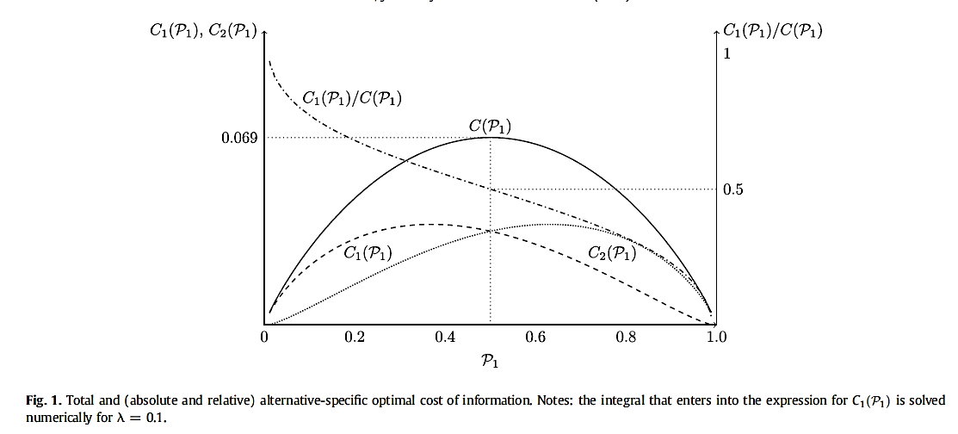
Optimal cost of information
Procedure of optimization of information acquisitions :
we simplify the model to just two alternatives
Calculating Choice Probability by formula called “logistic distribution”
The cost of gathering information about each option depends on how likely it is to be chosen.
Resulted in
The total cost of gathering info is highest when both options are equally likely to be chosen.
More money is spent on learning about the less attractive option.
As the likelihood of picking Option 1 increases, the proportion of money spent on gathering info about it decreases.

Slide 9

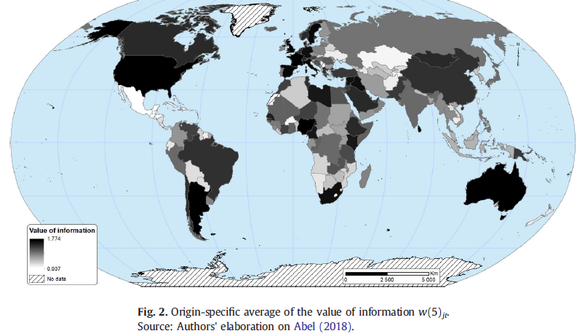
From theory to data
Data on international migration flows from Abel (2018), covering 203 countries over the period 1960 to 2015.
estimate the "value of information," a proxy for the cost of information acquisition.
Paper focuses on seven consecutive five-year periods between 1980 and 2015, with a total of 263,008 observations.
there's no distinct geographical trend in the data, with significant variability i within regions like Latin America and Sub-Saharan Africa.

Slide 10

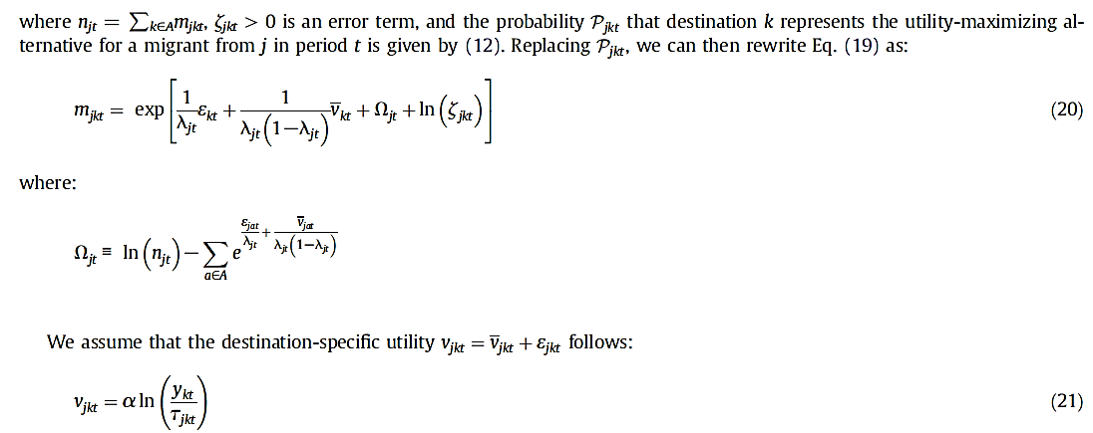
Economic analysis
Implementing “ Gravity model for Rational Inattention”
For simplifying the economic analysis and reveal that how appealing a destination is, the economic factor (like real GDP per person), and the costs involved in moving.
a method called Poisson pseudo-maximum-likelihood to estimate the equations.
Consider migration flows >>might be Zero
Notes:
The value of information costs varies based on the origin and timing of migration decisions, rather than solely relying on past migration trends.

Slide 11

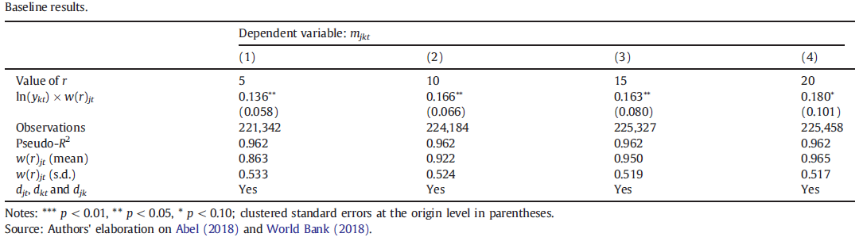
main findings on the relationship between the value of information and migration
different variant of the empirical counterpart for the value of information
for a specific origin country j
in a five-year period starting in year t.
The findings indicate that the coefficient (^β) of the interaction between destination GDP per capita and the time-varying origin-specific value of information is consistently positive and statistically significant.
increase in the value of w(r)jt is associated with an increase in the elasticity of the bilateral migration rate with respect to GDP per capita at destination.

Slide 12
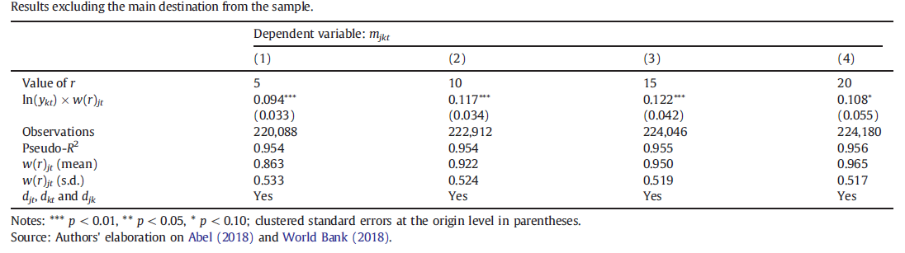
Model Prediction
include lagged data from all destinations
robustness of our results by excluding the primary origin-time specific destination from the analysis.
As shown in Table 3, although the estimated coefficient for β decreases slightly across all definitions of the value of information, it remains statistically significant and consistent with our main findings
Reality
migrants would consider all options when deciding where to move
migration flows are zero.
migrants forming smaller consideration sets

Slide 13
Outline of the paper and my research
Objective
Investigate how rational inattention influences migrant destination choices and whether migrants prioritize specific aspects of destinations due to cognitive limitations.
My research aims to :
explore onward migration within specific migrant communities in Japan.
focusing on the motivations behind internal relocation within their new destination.
subsequent relocation across different regions worldwide.
Looking to the experience of living in new environments motivates migrants.
examine the relationship between the experience of international relocation and onward migration.
exploring how these two phenomena interact and influence each other. ( time span concept refer to the fact that having spent years in one destination equips migrants with more knowledge about opportunities and shortcomings of their current place.)
Data
Utilize international migration databases, longitudinal surveys, and possibly experiments to gather data on migrants' decision-making processes.
Method
Employ econometric techniques like panel data analysis or structural equation modeling to quantify the relationship between rational inattention and migration decisions
Problem
Challenges include identifying suitable proxies for rational inattention and addressing endogeneity concerns
Results
Illustrate how rational inattention impacts migration decisions.
suggesting migrants prioritize certain destination attributes due to cognitive limitations.
Notes:
Contextual variable like job, income, social bonding, educations, reasons for travel, to name but a few will be used.
Consider set of variables not only economical or social factors to obtain overall perspective of migrants about relocation.
Providing the choice set from begging is difficult because we don’t want to be limited to specific groups or regions for this reason, survey will conduct to gather basic information and set the choices.

